Slide 1
DEPARTMENT OF ELECTRICAL AND ELECTRONICS ENGINEERING
REVIEW-1

Slide 2
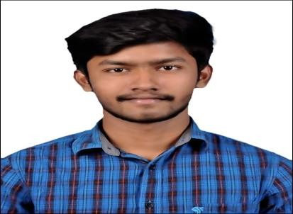
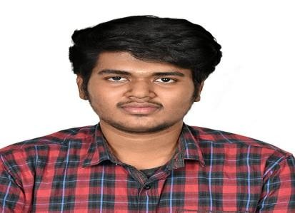
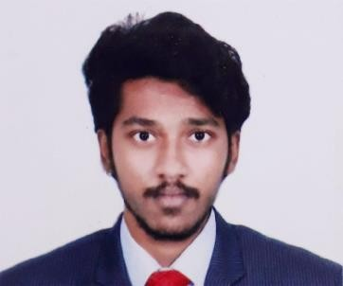

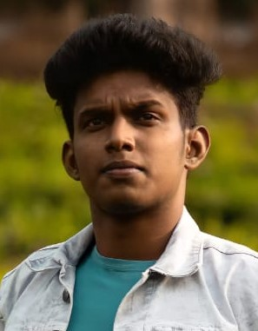
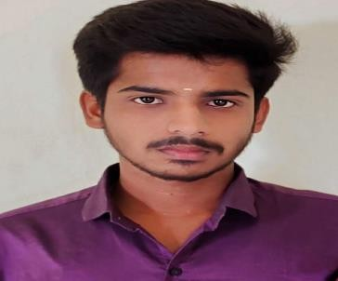
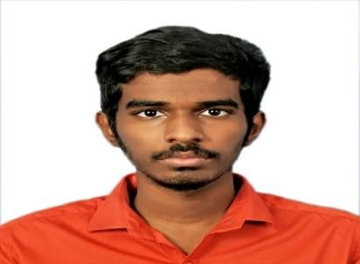
TEAM NAME:CODE RED
TEAM MEMBERS:-
JEFF MARSHAL
LOKESHWAR
MOHAMED ROHITH
AKASH
GOWSICK
LAKSHMANAMANI
KINGSLY JEBARAJ

Slide 3


Slide 4
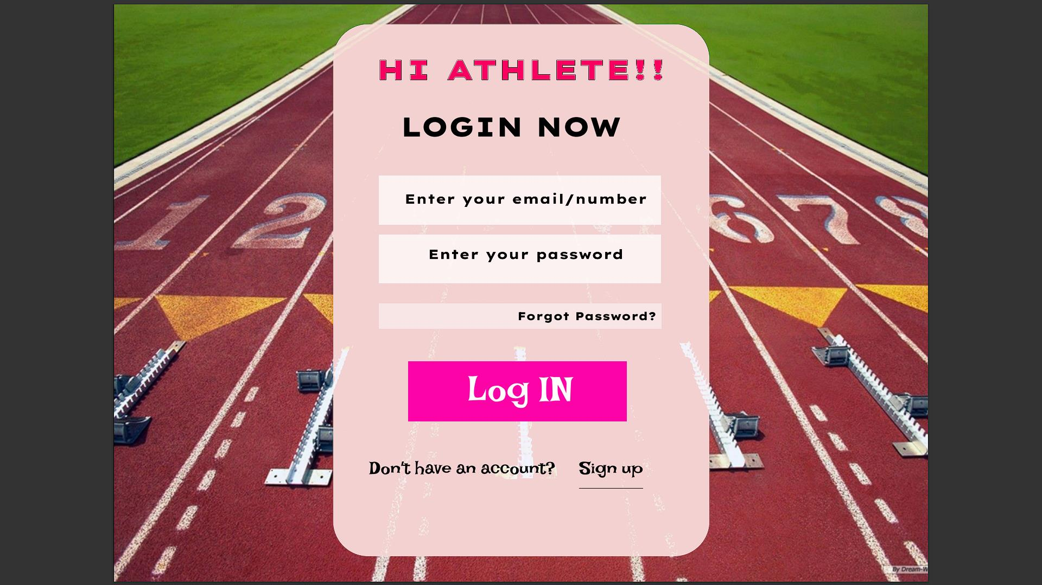

Slide 5
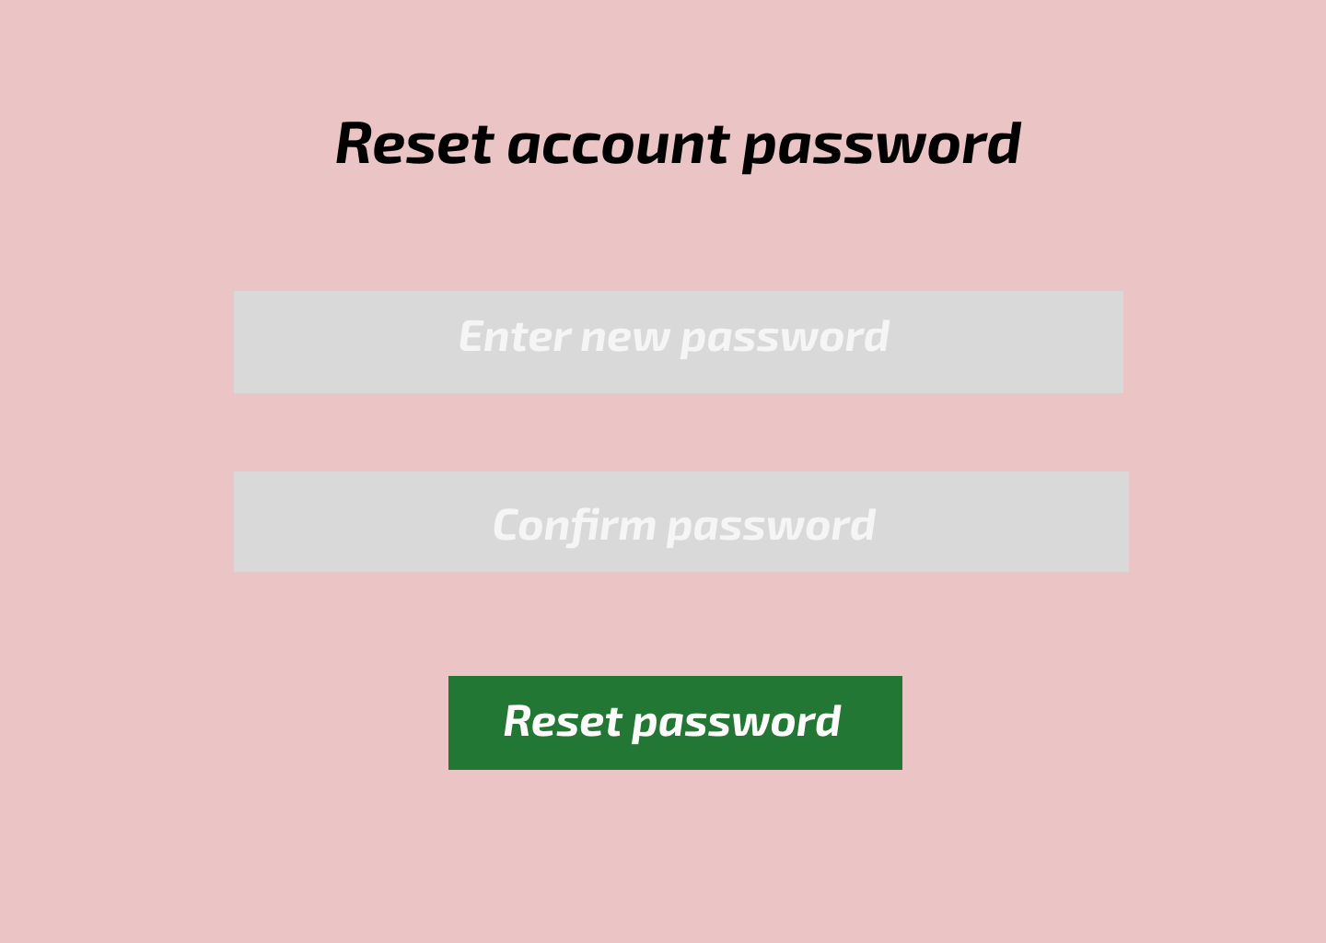

Slide 6
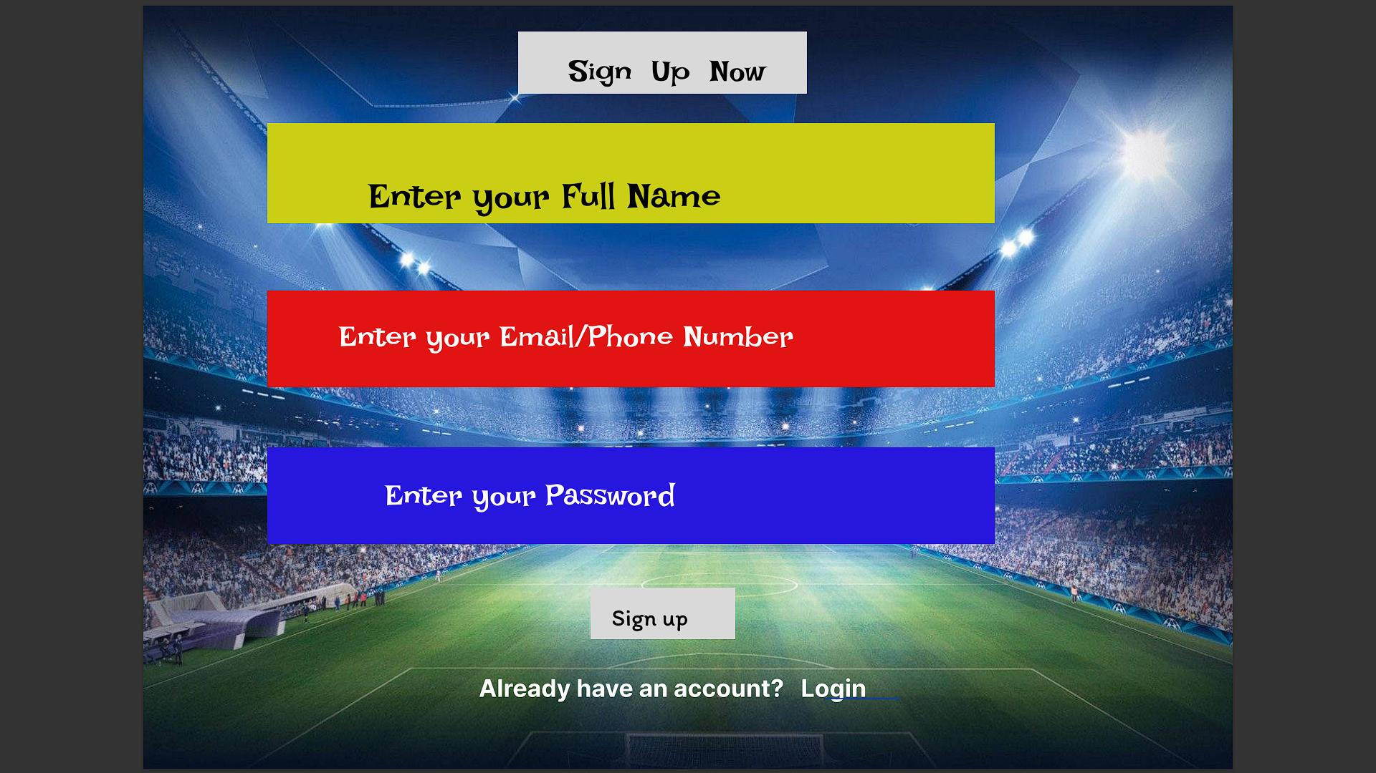

Slide 7


Slide 8


Slide 9


